Slide 1
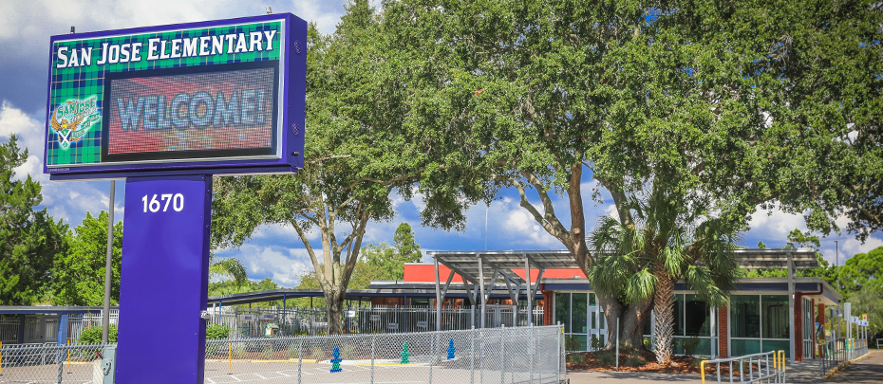
STATE OF THE SCHOOL
JANUARY 2024

Slide 2
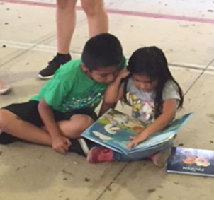
SAN JOSE IS YOUR NEIGHBORHOOD SCHOOL
Our story is more than 60 years strong
We are generations of families
We are generations of teachers​
We are generations of traditions​
We are a reflection of the Dunedin community
We are San Jose

Slide 3
POINTS OF PRIDE

Slide 4
San Jose awarded
“A” School Grade
Florida Department of Education
2022-2023

Slide 5
WE ARE AN “A" SCHOOL
 | ELA | Math | Science
Proficiency2023 | 60% | 77% | 79%
Goals 2024 | 65% | 80% | 80%

Slide 6
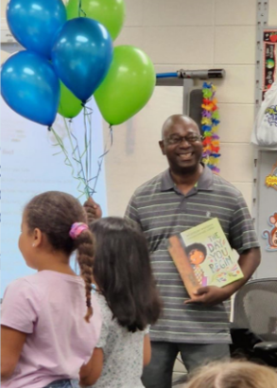
WE ARE INSPIRING TEACHERS
Karen Laughlin- “It Factor”​
Robert Gore- “It Factor”​
Jennifer Lumm- “It Factor”​
Whitney Vincent- “It Factor”​

Slide 7
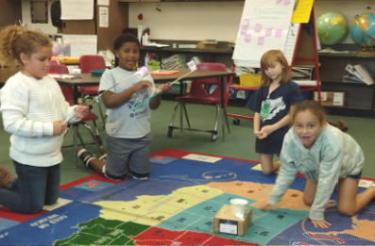
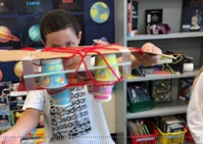
WE ARE GIFTED EDUCATION
Onsite 5 days a week​
Talent Development Program​
Enrichment Class enhancement
Universal Screening in Grade 1​
Clustering in Grades 3 and 5

Slide 8
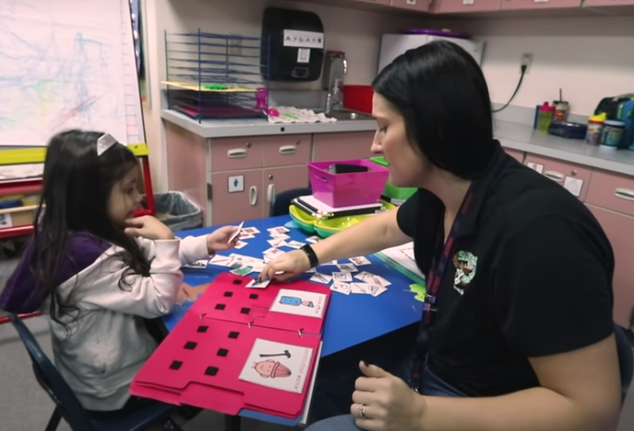
WE ARE EXCEPTIONAL STUDENT EDUCATION
3 Autism Spectrum Disorder (ASD) classes​
6 PreK classes:​
2 ASD​
2 PreK -3 year old​
2 VPK​
Sensory room, in class sensory support, and specialized playground equipment

Slide 9
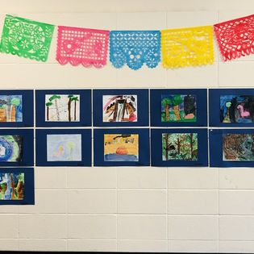
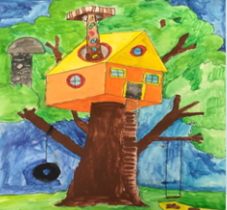
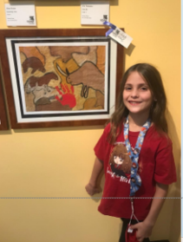
WE ARE ART AWARD WINNERS

Slide 10
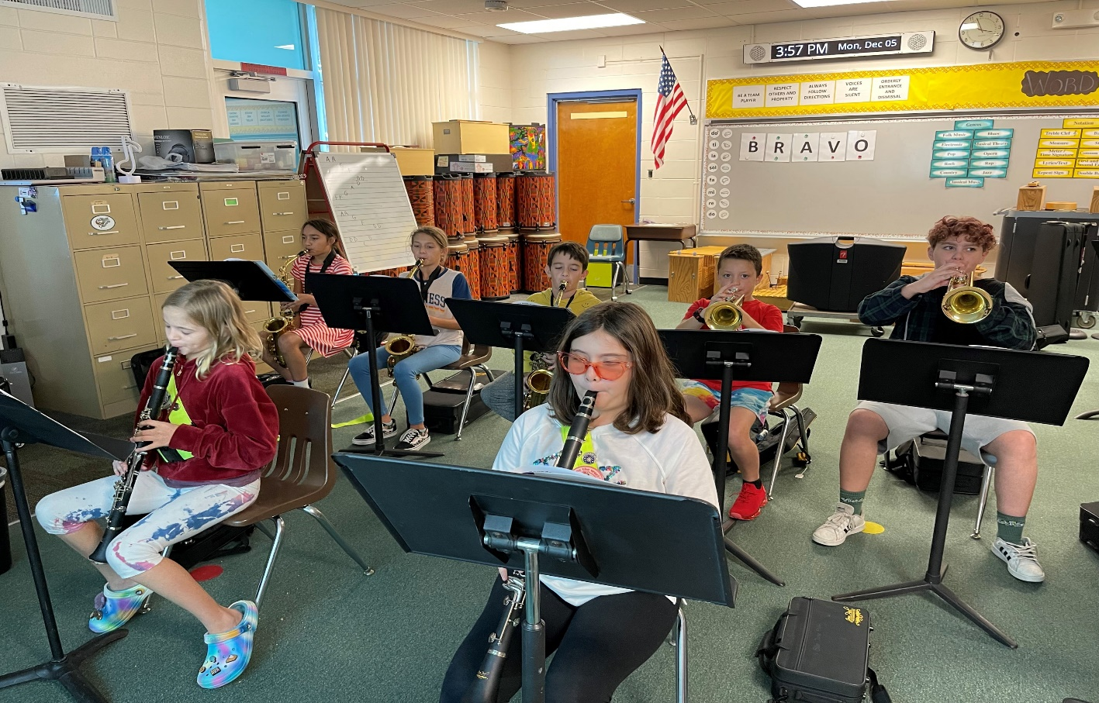
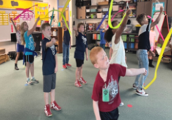
WE ARE MUSIC EDUCATION
After school Music Clubs​
Band Instruments ​
Chorus​

Slide 11
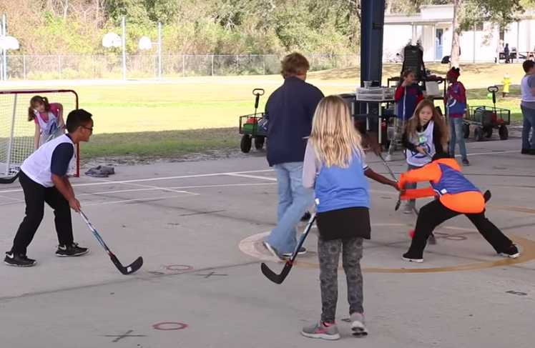
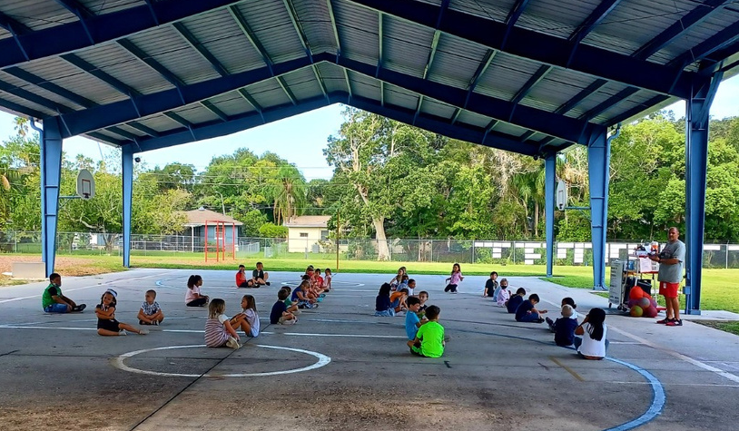
WE ARE PHYSICAL EDUCATION
150 minutes of instruction per week for all students PreK – 5th grade​
Adaptive PE curriculum, activities, and events for ASD and PreK students​
American Heart Association- Kids Heart Challenge (jump rope for heart)

Slide 12
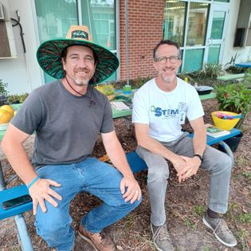
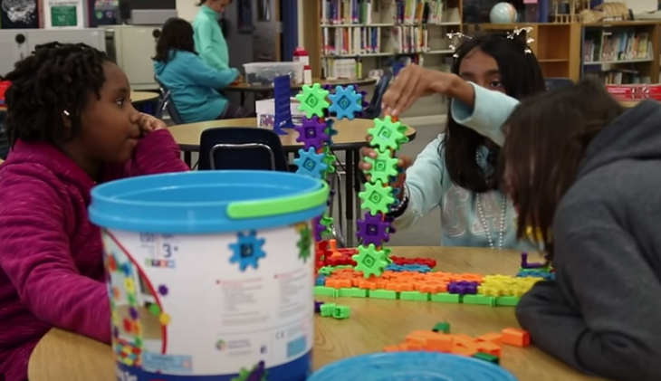
WE ARE STEM
Six afterschool STEM clubs​
Science Club
Laptops for all students​
Coding- Bee Bots grant​
Robotics Club

Slide 13
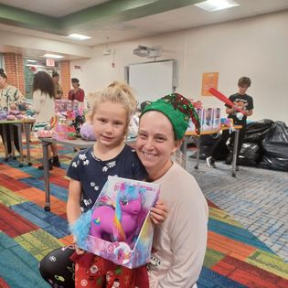
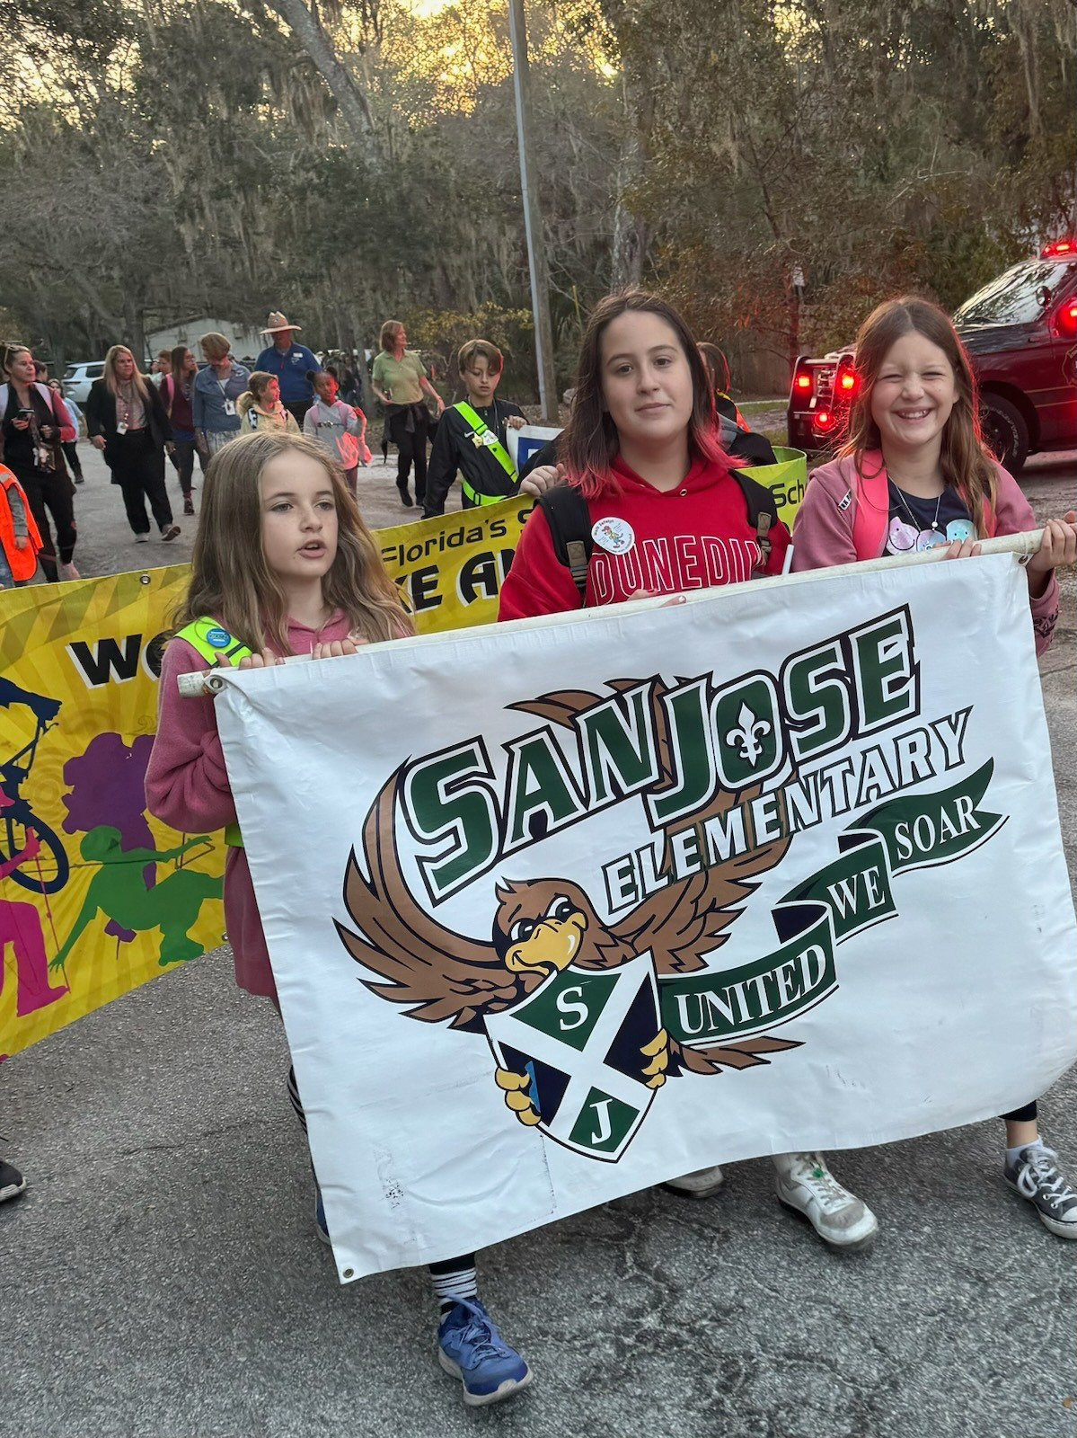
WE ARE FAMILY TRADITIONS
Fall Festival & Trunk or Treat​
Family Literacy Night- Winter Wonderland​
STEM Night​
Reading Under the Stars
Goodies with Grandparents​
Muffins with Mom​
Doughnuts with Dad​
Walk to School Day

Slide 14
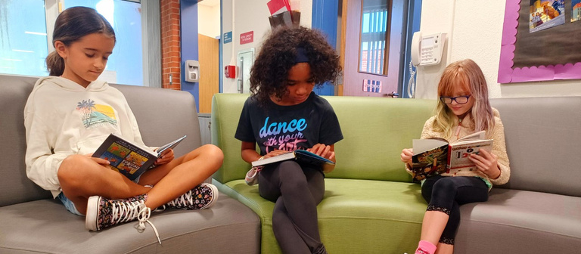
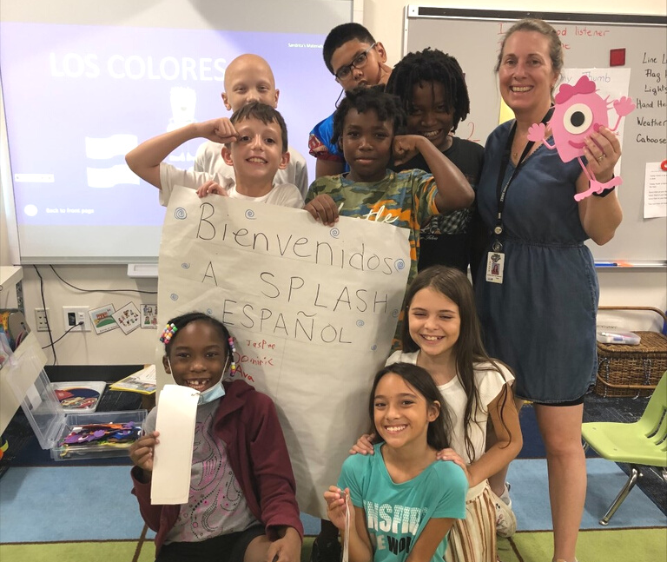
WE ARE EDUCATING THE WHOLE CHILD
Positive Behaviors System School Store​
Promise Time afterschool tutoring​
Walk and Talk, Recess​
School Garden and Harvest
2 Spanish Clubs
2 Art Clubs
Kiwanis Club
Music Club

Slide 15
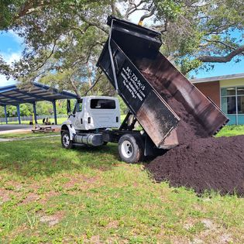
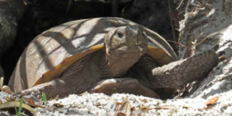
WE ARE CARING FOR OUR FUTURE
We are educating children about our earth through our School Garden
K-1 Outdoor Classroom
Hawk Family Market- school food pantry sponsored by Feeding Tampa Bay

Slide 16
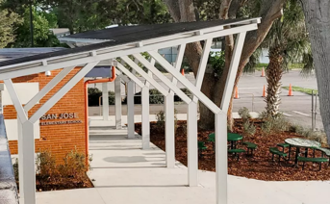
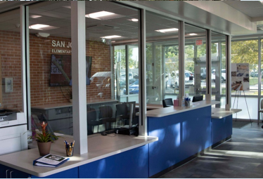
WE ARE STATE OF THE ART
Main Office Enhancement​
Cafeteria Modernization​
Secure PreK Building​
Entrance revitalization increasing our community presence

Slide 17
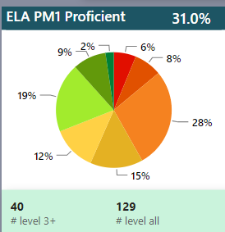
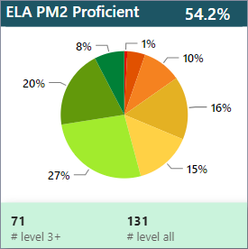
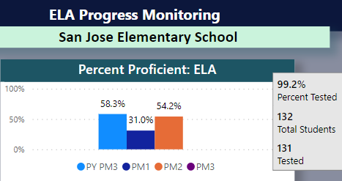
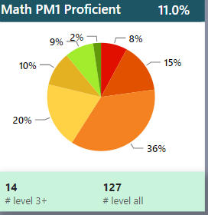
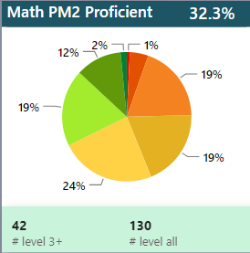
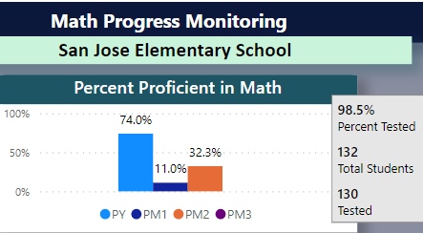
WE ARE GROWING SUCCESS 2023-2024

Slide 19
WE ARE YOUR NEIGHBORHOOD SCHOOL!
WE OFFER PERSONAL SCHOOL TOURS. COME SEE ALL THAT WE HAVE TO OFFER.​

